Slide 1
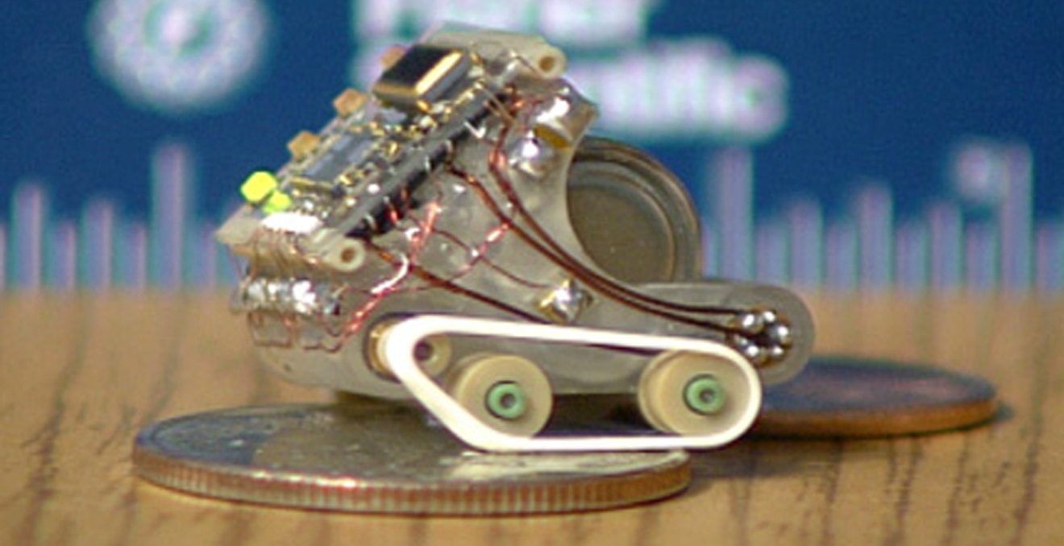
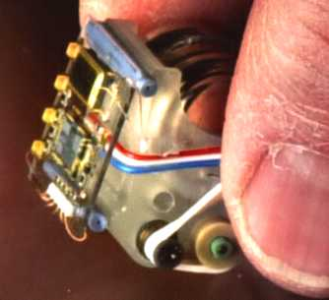
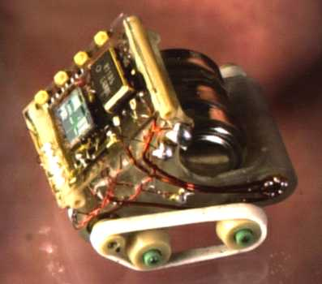
Wheeled Robots
~ 1.5 cm to a side
temperature sensor & two motors
travels 1 inch in 3 seconds
untethered !!

Slide 2
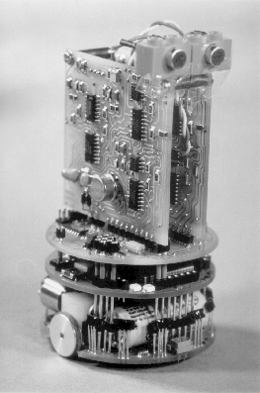
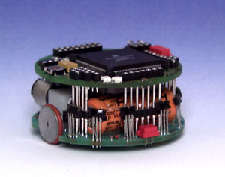
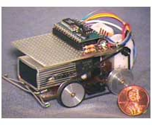




Other mini machines
Pocketbot
55mm dia. base
radio unit
Khepera
linear vision
gripper
“Cricket”
video

Slide 3
Forward Kinematics of Differential drive

Slide 4
Kinematics of Differential drive
Differential Drive is the most common kinematic choice
- difference in wheels’ speeds determines its turning angle
All of the miniature robots…
Pioneer, Rug warrior
Questions (forward kinematics)
Given the wheel’s velocities or positions, what is the robot’s velocity/position ?
V_{L}
Are there any inherent system constraints?
V_{R}
1) Specify system measurements
2) Determine the point (the radius) around which the robot is turning.
3) Determine the speed at which the robot is turning to obtain the robot velocity.
4) Integrate to find position.

Slide 5
Kinematics of Differential drive
1) Specify system measurements
y
- consider possible coordinate systems
V_{L}
x
θ
2d
V_{R}
(assume a wheel radius of 1)

Slide 6
Kinematics of Differential drive – radius of turning
1) Specify system measurements
y
- consider possible coordinate systems
2) Determine the point (the radius) around which the robot is turning.
V_{L}
x
θ
2d
V_{R}
ICC “instantaneous center of curvature”
(assume a wheel radius of 1)

Slide 7
Kinematics of Differential drive – angular velocity
1) Specify system measurements
y
- consider possible coordinate systems
2) Determine the point (the radius) around which the robot is turning.
- to minimize wheel slippage, this point (the ICC) must lie at the intersection of the wheels’ axles
V_{L}
x
- each wheel must be traveling at the same angular velocity
θ
2d
V_{R}
ICC “instantaneous center of curvature”
(assume a wheel radius of 1)
ϖ = angular velocity

Slide 8
Kinematics of Differential drive
1) Specify system measurements
y
- consider possible coordinate systems
2) Determine the point (the radius) around which the robot is turning.
ω
- to minimize wheel slippage, this point (the ICC) must lie at the intersection of the wheels’ axles
V_{L}
x
- each wheel must be traveling at the same angular velocity around the ICC
θ
2d
V_{R}
ICC “instantaneous center of curvature”
(assume a wheel radius of 1)

Slide 9
Kinematics of Differential drive
1) Specify system measurements
y
- consider possible coordinate systems
2) Determine the point (the radius) around which the robot is turning.
ω
- each wheel must be traveling at the same angular velocity around the ICC
V_{L}
x
3) Determine the robot’s speed around the ICC and its linear velocity
2d
V_{R}
ICC
ω(R+d) = V_{L}
R
robot’s turning radius
ω(R-d) = V_{R}
(assume a wheel radius of 1)

Slide 10
Kinematics of Differential drive
1) Specify system measurements
y
- consider possible coordinate systems
2) Determine the point (the radius) around which the robot is turning.
ω
- each wheel must be traveling at the same angular velocity around the ICC
V_{L}
x
3) Determine the robot’s speed around the ICC and then linear velocity
2d
V_{R}
ICC “instantaneous center of curvature”
ICC
ω(R+d) = V_{L}
R
robot’s turning radius
ω(R-d) = V_{R}
Thus,
ω = ( V_{R} - V_{L} ) / 2d
R = 2d ( V_{R} + V_{L} ) / ( V_{R} - V_{L} )
(assume a wheel radius of 1)

Slide 11
Kinematics of Differential drive – robot’s velocity
1) Specify system measurements
y
- consider possible coordinate systems
2) Determine the point (the radius) around which the robot is turning.
ω
- each wheel must be traveling at the same angular velocity around the ICC
V_{L}
x
3) Determine the robot’s speed around the ICC and then linear velocity
2d
V_{R}
ICC
ω(R+d) = V_{L}
R
robot’s turning radius
ω(R-d) = V_{R}
Thus,
ω = ( V_{R} - V_{L} ) / 2d
R = 2d ( V_{R} + V_{L} ) / ( V_{R} - V_{L} )
So, the robot’s velocity is
V = ωR = ( V_{R} + V_{L} ) / 2

Slide 12
Kinematics of Differential drive – integrate to obtain position
4) Integrate to obtain position
y
V_{x} = V(t) cos(θ(t))
ω(t)
V_{y} = V(t) sin(θ(t))
V(t)
θ(t)
V_{L}
x
Vx
2d
V_{R}
ICC “instantaneous center of curvature”
ICC
R(t)
robot’s turning radius
with
ω = ( V_{R} - V_{L} ) / 2d
R = 2d ( V_{R} + V_{L} ) / ( V_{R} - V_{L} )
What has to happen to change the ICC ?
V = ωR = ( V_{R} + V_{L} ) / 2

Slide 13
Kinematics of Differential drive
4) Integrate to obtain position
y
V_{x} = V(t) cos(θ(t))
ω(t)
V_{y} = V(t) sin(θ(t))
Thus,
x(t) = ∫ V(t) cos(θ(t)) dt
V_{L}
x
y(t) = ∫ V(t) sin(θ(t)) dt
2d
θ(t) = ∫ ω(t) dt
V_{R}
ICC
R(t)
robot’s turning radius
with
ω = ( V_{R} - V_{L} ) / 2d
R = 2d ( V_{R} + V_{L} ) / ( V_{R} - V_{L} )
V = ωR = ( V_{R} + V_{L} ) / 2

Slide 14
Kinematics of Differential drive – velocity components
Velocity Components
y
V_{x} = V(t) cos(θ(t))
speed
ω(t)
V_{y} = V(t) sin(θ(t))
Thus,
x(t) = ∫ V(t) cos(θ(t)) dt
V_{L}
x
y(t) = ∫ V(t) sin(θ(t)) dt
2d
θ(t) = ∫ ω(t) dt
V_{R}
ICC
R(t)
Kinematics
robot’s turning radius
with
ω = ( V_{R} - V_{L} ) / 2d
R = 2d ( V_{R} + V_{L} ) / ( V_{R} - V_{L} )
What has to happen to change the ICC ?
V = ωR = ( V_{R} + V_{L} ) / 2

Slide 15
Forward
Kinematics
of Synchro
Drive

Slide 16
Kinematics of Synchro drive – wheels synchronized
Nomad 200
wheels rotate in tandem and remain parallel
all of the wheels are driven at the same speed
Where is the ICC ?

Slide 17
Kinematics of Synchro drive – velocity and position
Nomad 200
wheels rotate in tandem and remain parallel
all of the wheels are driven at the same speed
ICC at ∞
y
V_{robot} = V_{wheels}
velocity
ω
ω_{robot} = ω_{wheels}
θ
x
θ(t) = ∫ ω(t) dt
V_{wheels}
x(t) = ∫ V_{wheels}(t) cos(θ(t)) dt
position
y(t) = ∫ V_{wheels}(t) sin(θ(t)) dt
simpler to control, but ...

Slide 18
Kinematics of Synchro drive –
forward kinematics
Nomad 200
wheels rotate in tandem and remain parallel
all of the wheels are driven at the same speed
Question (forward kinematics)
Given the wheel’s velocities or positions, what is the robot’s velocity/position ?
Are there any inherent system constraints?
1) Choose a robot coordinate system
2) Determine the point (the radius) around which the robot is turning.
3) Determine the speed at which the robot is turning to obtain the robot velocity.
4) Integrate to find position.

Slide 19
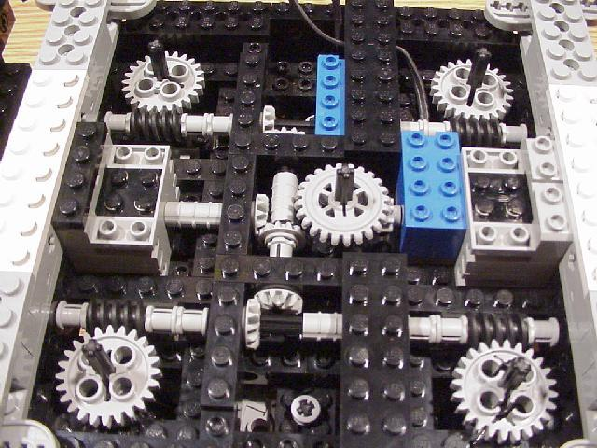
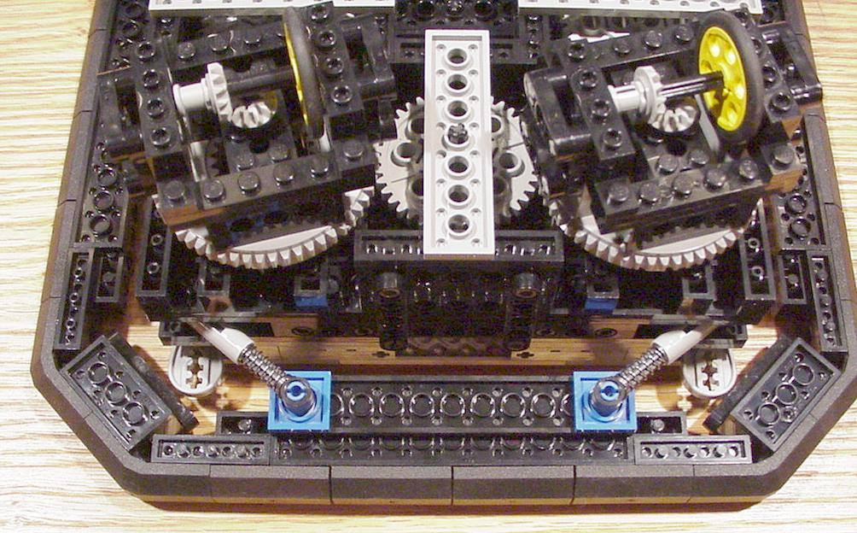
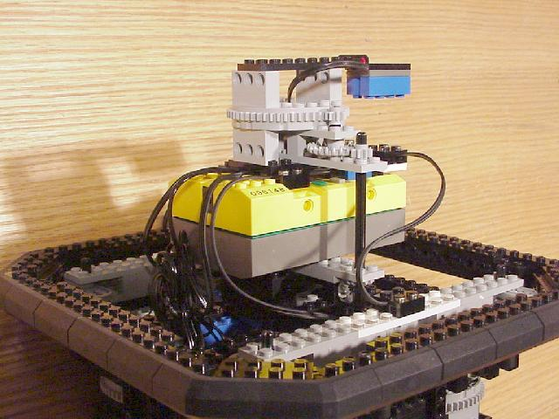
Synchro Drive using Lego
this light sensor follows the direction of the wheels, but the RCX is stationary
also, four bump sensors and two motor encoders are included
more difficult to build.
But how do we get somewhere?

Slide 20
Inverse Kinematics of Differential Drive

Slide 21
Inverse Kinematics – the problem
Key question:
Given a desired position or velocity, what can we do to achieve it?
y
V_{L} (t)
x
V_{R}(t)
starting position
final position

Slide 22
Inverse Kinematics – one solution
Key question:
Given a desired position or velocity, what can we do to achieve it?
y
V_{L} (t)
x
V_{R}(t)
starting position
final position

Slide 23
Inverse Kinematics – another solution
Key question:
Given a desired position or velocity, what can we do to achieve it?
y
V_{L} (t)
x
V_{R}(t)
starting position
final position

Slide 24
Inverse Kinematics – many numerical solutions to equations
Key question:
Given a desired position or velocity, what can we do to achieve it?
y
Need to solve these equations:
x = ∫ V(t) cos(θ(t)) dt
y = ∫ V(t) sin(θ(t)) dt
V_{L} (t)
x
θ = ∫ ω(t) dt
V_{R}(t)
ω = ( V_{R} - V_{L} ) / 2d
V = ωR = ( V_{R} + V_{L} ) / 2
starting position
final position
for V_{L} (t) and V_{R}(t) .
There are lots of solutions...

Slide 25
Inverse Kinematics – finding the best solution
Key question:
Given a desired position or velocity, what can we do to achieve it?
y
Finding some solution is not hard, but finding the “best” solution is very difficult...
V_{L} (t)
x
quickest time
most energy efficient
smoothest velocity
profiles
V_{R}(t)
starting position
final position
V_{L} (t)
V_{L} (t)
t
It all depends on who gets to define “best”...

Slide 26
Inverse Kinematics - decomposition
Usual approach: decompose the problem and control only a few DOF at a time
Differential Drive
y
V_{L} (t)
x
V_{R}(t)
starting position
final position

Slide 27
Inverse Kinematics – decomposition for Differential Drive
Usual approach: decompose the problem and control only a few DOF at a time
Differential Drive
(1) turn so that the wheels are parallel to the line between the original and final position of the robot origin.
y
-V_{L} (t) = V_{R} (t) = V_{max}
V_{L} (t)
x
V_{R}(t)
starting position
final position

Slide 28
Inverse Kinematics
Usual approach: decompose the problem and control only a few DOF at a time
Differential Drive
(1) turn so that the wheels are parallel to the line between the original and final position of the robot origin.
y
-V_{L} (t) = V_{R} (t) = V_{max}
(2) drive straight until the robot’s origin coincides with the destination
V_{L} (t)
x
V_{L} (t) = V_{R} (t) = V_{max}
V_{R}(t)
starting position
final position

Slide 29
Inverse Kinematics
Usual approach: decompose the problem and control only a few DOF at a time
Differential Drive
(1) turn so that the wheels are parallel to the line between the original and final position of the robot origin.
y
-V_{L} (t) = V_{R} (t) = V_{max}
(2) drive straight until the robot’s origin coincides with the destination
V_{L} (t)
x
V_{L} (t) = V_{R} (t) = V_{max}
V_{R}(t)
(3) rotate again in order to achieve the desired final orientation
starting position
final position
-V_{L} (t) = V_{R} (t) = V_{max}
V_{L} (t)
V_{R} (t)
t

Slide 30
Inverse Kinematics of Synchro Drive

Slide 31
Inverse Kinematics of Synchro Drive
Usual approach: decompose the problem and control only a few DOF at a time
Synchro Drive
(1) turn so that the wheels are parallel to the line between the original and final position of the robot origin.
y
V(t)
ω(t) = ω_{max}
(2) drive straight until the robot’s origin coincides with the destination
x
V(t) = V_{max}
ω(t)
(3) rotate again in order to achieve the desired final orientation
final position
ω(t) = ω_{max}
starting position
sometimes it’s not so easy to isolate one or two DOF...

Slide 32
Other wheeled robots
tricycle drive
Ackerman drive
Doubly-steered bicycle
one more -- that roaming desk
one more -- that roaming tatami mat (holonomic) & the XR4000

Slide 33
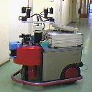
Kinematics of Tricycle drive
back wheels tag along...
front wheel is powered and steerable
Mecos tricycle-drive robot

Slide 34
Kinematics of Four-wheel Steering

Slide 35
Four-wheel Steering
The kinematic challenges of parallel parking:
wheels have limited turning angles
no in-place rotation
small space for parking and maneuvers
V_{FL}
V_{FR}
V_{BL}
V_{BR}

Slide 36
Ackerman Steering
α_{L}
Similar to a tricycle-drive robot
α_{R}
y
r
=
g
+ d
V_{FL}
tan(α_{R})
ωg
=
V_{FR}
sin(α_{R})
V_{FR}
g
determines ω
V_{BL}
d
d
V_{BR}
x
r
ICC

Slide 37
Ackerman Steering
α_{L}
Similar to a tricycle-drive robot
α_{R}
y
r
=
g
+ d
V_{FL}
tan(α_{R})
ωg
=
V_{FR}
sin(α_{R})
V_{FR}
g
determines ω
The other wheel velocities are now fixed!
V_{BL}
d
ωg
d
=
V_{FL}
sin(α_{L})
V_{BR}
α_{L} = tan⁻¹(g / (r + d))
x
ω(r - d) = V_{BR}
ω(r + d) = V_{BL}
r
ICC
But this is just the cab...

Slide 38
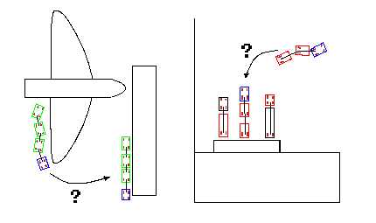
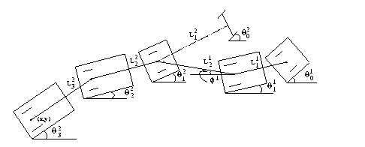
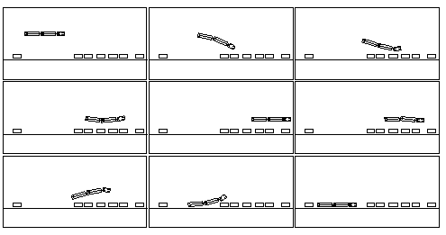
The Big Rigs
Applications
5 link trailer
2 controlled angles
Parking two trailers

Slide 39
Holonomic Robots

Slide 40
nonholonomicity
All of the robots mentioned share an important (if frustrating) property: they are nonholonomic .
- makes it difficult to navigate between two arbitrary points
- need to resort to techniques like parallel parking

Slide 41
nonholonomicity
All of the robots mentioned share an important (if frustrating) property: they are nonholonomic.
- makes it difficult to navigate between two arbitrary points
- need to resort to techniques like parallel parking
By definition, a robot is nonholonomic if it can not move to change its pose instantaneously in all available directions.
i.e., the robot’s differential motion is constrained.
Synchro Drive
two DOF are freely controllable; the third is inaccessible

Slide 42
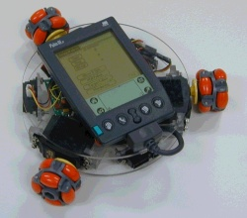
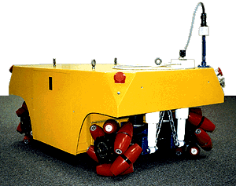
Holonomic Robots
Navigation is simplified considerably if a robot can move instantaneously in any direction, i.e., is holonomic.
Omniwheels
Mecanum wheels
tradeoffs in locomotion/wheel design
if it can be done at all ...

Slide 43
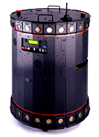
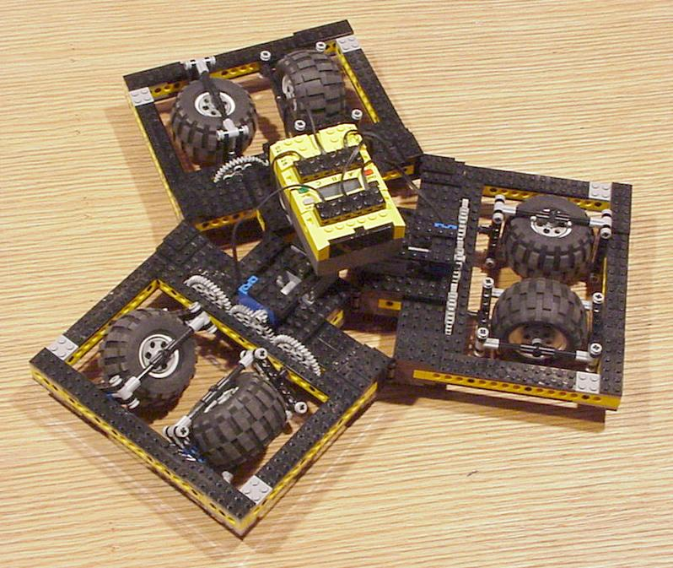
Holonomic Robots
Nomad XR4000
Killough’s Platform
synchro drive with offsets from the axis of rotation

Slide 44
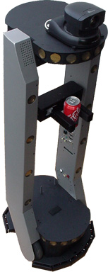
Holonomic Hype
Holonomic hype
“The PeopleBot is a highly holonomic platform, able to navigate in the tightest of spaces…”
Not true
GUIDEBOT IS NOT HOLONOMIC
NEWTON IS HOLONOMIC – Omni wheels
MCECSBOT IS HOLONOMIC – MECCANO WHEELS

Slide 45
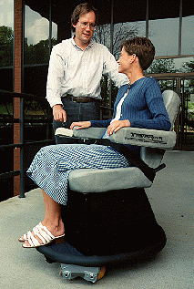
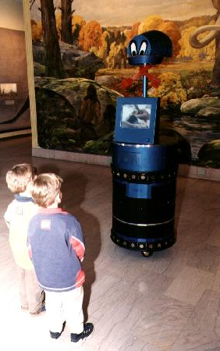
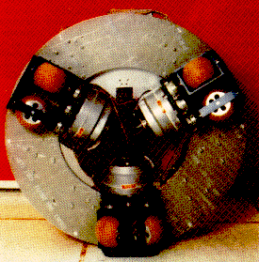
Holonomic Hype
Discover ‘97 -- Top 10 Innovation
Sage -- a museum tour guide

Slide 46
Sources
Prof. Maja Mataric
Dr. Fred Martin
Bryce Tucker and former PSU students
A. Ferworn,
Prof. Gaurav Sukhatme, USC Robotics Research Laboratory
Paul Hannah
Reuven Granot, Technion
Dodds, Harvey Mudd College

